Slide 1


BASIC CRYPTOGRAPHY
Unit: 4
COMUTER SYSTEM SECURITY
Charvi
Assistant Professor
CS
Course Details
( B Tech 4th Sem)
Charvi KNC 301 CSS Unit-4

Slide 2

CONTENT
Public key cryptography ,
RSA public key crypto ,
Digital signature Hash functions Public key distribution
Real world protocols
Basic terminologies
Email security certificates Transport Layer security TLS
IP security
DNS security
Charvi KNC 301 CSS Unit-4

Slide 3
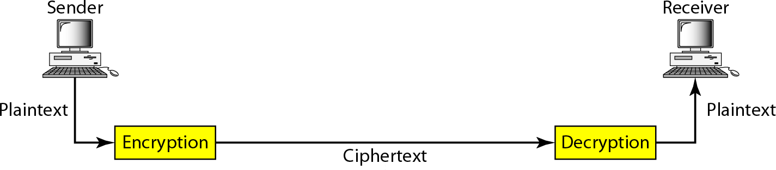
PUBLIC-KEY CRYPTOGRAPHY
Cryptography
To ensure secure transmission , data is sent in such a way that it looks completely different from the original data.
Plain text: data that to be secured
Cipher text: data after encryption
Encryption: the process of converting a plain text to cipher text.
Decryption: the process of regenerating the plaintext from cipher text
https://ict.iitk.ac.in/product/computer-system-security/
Charvi KNC 301 CSS Unit-4

Slide 4
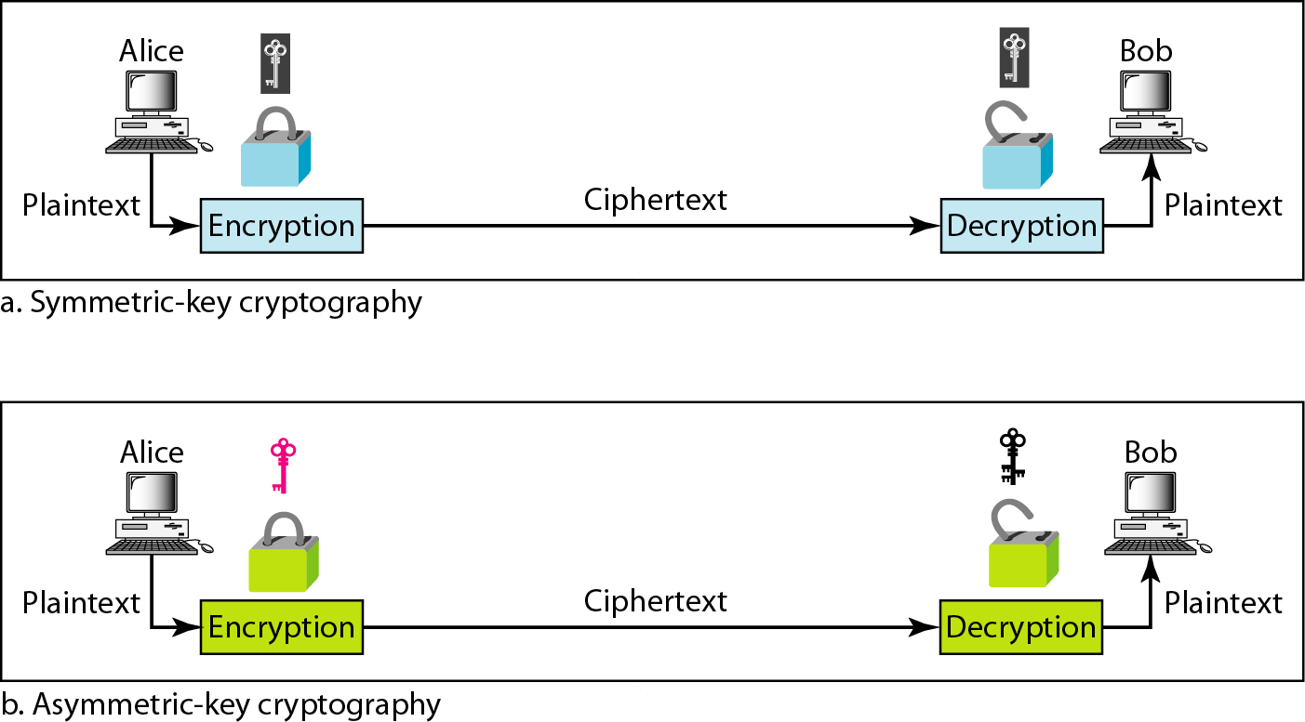
CATEGORIES OF CRYPTOGRAPHY
Image source- https://ict.iitk.ac.in/product/computer-system-security/
Charvi KNC 301 CSS Unit-4

Slide 5
SECRET KEY CRYPTOGRAPHY
Also called symmetric or single key algorithm.
Encryption and decryption are with same key.
Techniques based on permutation and substitution.
Stream cipher operate on single key.
Block cipher operate on blocks
Advantage –simple, fast
Disadvantage –key exchange ,key management.
Charvi KNC 301 CSS Unit-4

Slide 6
SECRET KEY ASSURANCE
Confidentiality: First, cryptography protects the confidentiality (or secrecy) of information. Even when the transmission or storage medium has been compromised, the encrypted information is practically useless to unauthorized persons without the proper keys for decryption.
Integrity: Cryptography can also be used to ensure the integrity (or accuracy) of information through the use of hashing algorithms and message digests.
Authentication: Finally, cryptography can be used for authentication (and non-repudiation) services through digital signatures, digital certificates, or a Public Key Infrastructure (PKI).
Non repudiation-sender can not deny a file was sent.this can not be done using secret key alone.
Charvi KNC 301 CSS Unit-4

Slide 7
EXAMPLE-NON REPUDIATION
Case-1
Alice send a stock buy request to bob.
Bob does not buy and claim that he never received the request.
Case 2
Alice send a stock buy request to bob.
Bob send an acknowledge message.
Bob does not buy and claim that he never received the request
Alice present acknowledge msg as proof.
Charvi KNC 301 CSS Unit-4

Slide 8
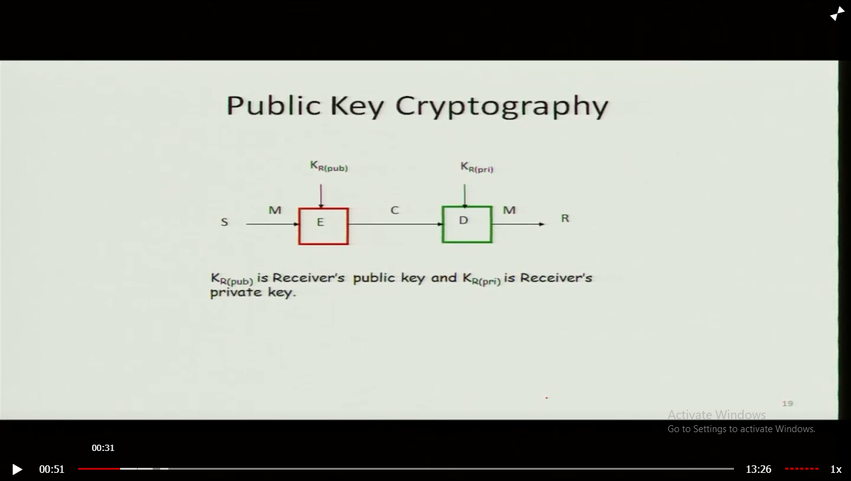
PUBLIC KEY CRYPTOGRAPHY
Public key algorithms are fundamental security ingredients in modern cryptosystems, applications and protocols assuring the confidentiality, authenticity and non-repudiability of electronic communications and data storage.
They underpin various Internet standards, such as Transport Layer Security (TLS), S/MIME, PGP, and GPG.
Some public key algorithms provide key distribution and secrecy (e.g., Diffie–Hellman key exchange), some provide digital signatures (e.g., Digital Signature Algorithm), and some provide both (e.g., RSA).
https://ict.iitk.ac.in/product/computer-system-security/
Charvi KNC 301 CSS Unit-4

Slide 9
PKC APPLICATION
Application of a public key encryption system is in encrypting communication to provide confidentiality .
Application in public key cryptography is the digital signature.
Further applications built on this foundation include: digital cash, password-authenticated key agreement.
asymmetric key algorithms are nearly always much more computationally intensive than symmetric ones, in many cases it is common to exchange a key using a key-exchange algorithm, then transmit data using that key and a symmetric key algorithm.
Charvi KNC 301 CSS Unit-4

Slide 10
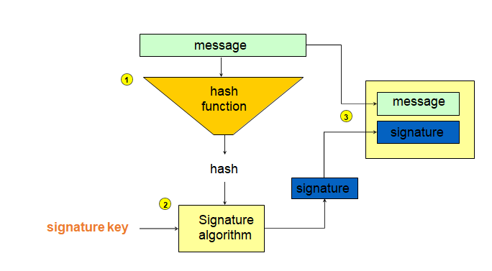
RSA ALGORITHM
The system was invented by three scholars Ron Rivest, Adi Shamir, and Len Adle man and hence, it is termed as RSA cryptosystem.
Creating an RSA signature with appendix
https://ict.iitk.ac.in/product/computer-system-security/
Charvi KNC 301 CSS Unit-4

Slide 11
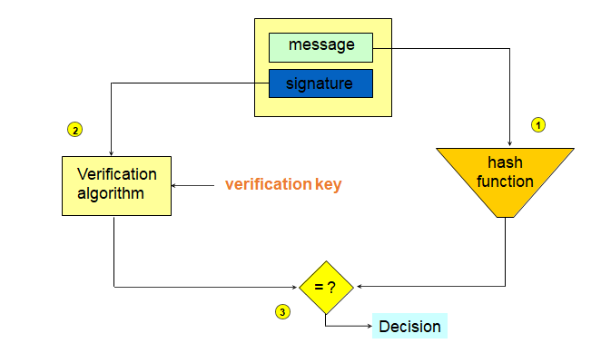
VERIFYING AN RSA SIGNATURE WITH APPENDIX
https://ict.iitk.ac.in/product/computer-system-security/
Charvi KNC 301 CSS Unit-4

Slide 12
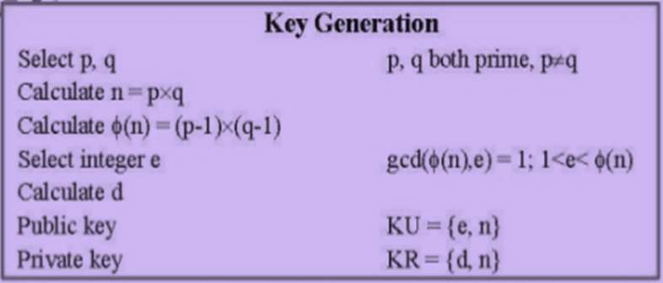
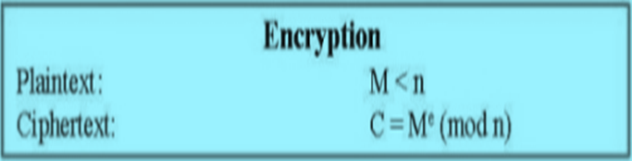
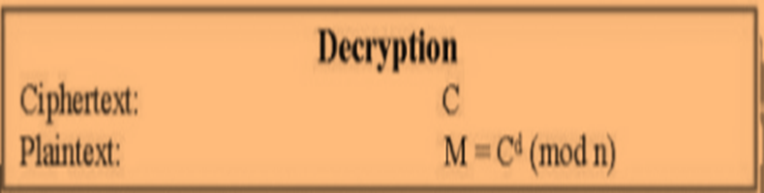
RSA ALGORITHM:
Charvi KNC 301 CSS Unit-4

Slide 13
DIGITAL SIGNATURE
A digital signature scheme typically consists of three algorithms;
A key generation algorithm that selects a private key uniformly at random from a set of possible private keys. The algorithm outputs the private key and a corresponding public key.
A signing algorithm that, given a message and a private key, produces a signature.
A signature verifying algorithm that, given the message, public key and signature, either accepts or rejects the message's claim to authenticity.
Charvi KNC 301 CSS Unit-4

Slide 14
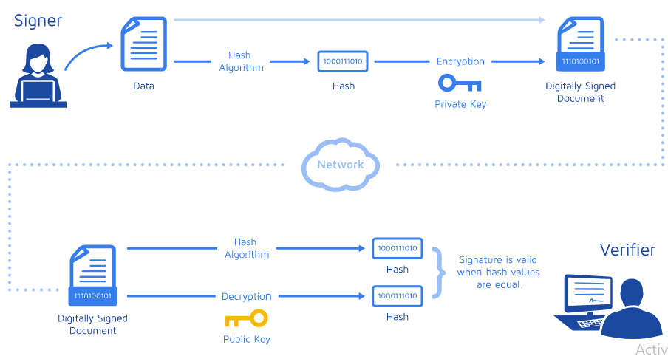
DIGITAL SIGNATURE WORKING
Image source-https://www.docusign.com/how-it-works/electronic-signature/digital-signature/digital-signature-faq
Charvi KNC 301 CSS Unit-4

Slide 15
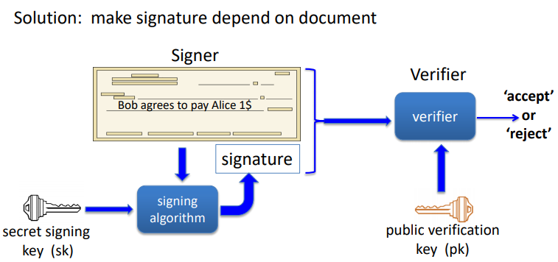
DIGITAL SIGNATURE
Digital signatures work through public key cryptography's two mutually-authenticating cryptographic keys.
The individual who is creating the digital signature uses their own private key to encrypt signature-related data; the only way to decrypt that data is with the signer's public key.
This is how digital signatures are authenticated.
https://crypto.stanford.edu/~dabo/courses/OnlineCrypto/slides/13-sigs.pdf
Charvi KNC 301 CSS Unit-4

Slide 16
CLASSES OF DIGITAL SIGNATURE
There are three different classes of Digital Signature Certificates:
Class 1: Cannot be used for legal business documents as they are validated based only on an email ID and username.
Class 2: Often used for e-filing of tax documents, including income tax returns and Goods and Services Tax (GST) returns.
Class 3: The highest level of digital signatures. Class 3 signatures require a person or organization to present in front of a certifying authority to prove their identity before signing
Charvi KNC 301 CSS Unit-4

Slide 17
USES OF DIGITAL SIGNATURES
Government
Healthcare
Manufacturing
Financial services
Charvi KNC 301 CSS Unit-4

Slide 18
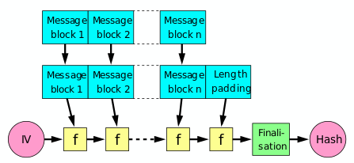
HASH FUNCTION
A cryptographic hash function (CHF) is a hash function that is suitable for use in cryptography.
It is a mathematical algorithm that maps data of arbitrary size (often called the "message") to a bit string of a fixed size (the "hash value", "hash", or "message digest") and is a one-way function, that is, a function which is practically infeasible to invert.
https://crypto.stanford.edu/cs155old/cs155-spring16/lectures/13-tcp-dns.pdf
Charvi KNC 301 CSS Unit-4

Slide 19
HASH FUNCTION
A hash function must be able to process an arbitrary-length message into a fixed-length output.
This can be achieved by breaking the input up into a series of equal-sized blocks, and operating on them in sequence using a one-way compression function. The compression function can either be specially designed for hashing or be built from a block cipher.
The last block processed should also be unambiguously length padded ; this is crucial to the security of this construction.
Charvi KNC 301 CSS Unit-4

Slide 20
HASH FUNCTION
The ideal cryptographic hash function has the following main properties:
it is deterministic meaning that the same message always results in the same hash
it is quick to compute the hash value for any given message
it is infeasible to generate a message that yields a given hash value
it is infeasible to find two different messages with the same hash value
a small change to a message should change the hash value so extensively that the new hash value appears uncorrelated with the old hash value
Charvi KNC 301 CSS Unit-4

Slide 21
APPLICATIONS
Verifying the integrity of messages and files
Signature generation and verification
Password verification
Proof-of-work
File or data identifier
Charvi KNC 301 CSS Unit-4

Slide 22
PUBLIC KEY DISTRIBUTION
Several techniques have been proposed for the distribution of public keys. Virtually all of these proposals can be grouped into the following general schemes:
A. Public announcement
B. Publicly available directory
C. Public-key authority
D. Public-key certificates
Charvi KNC 301 CSS Unit-4

Slide 23
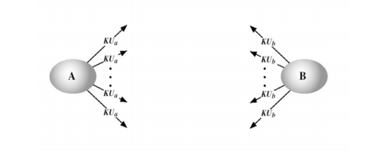
PUBLIC ANNOUNCEMENT OF PUBLIC KEYS
On the face of it, the point of public-key encryption is that the public key is public. Thus, if there is some broadly accepted public-key algorithm, such as RSA, any participant can send his or her public key to any other participant or broadcast the key to the community at large .
Although this approach is convenient, it has a major weakness. Anyone can forge such a public announcement.
IMAGE SOURCE-http://www.facweb.iitkgp.ac.in/~sourav/KeyManagement.pdf
Charvi KNC 301 CSS Unit-4

Slide 24
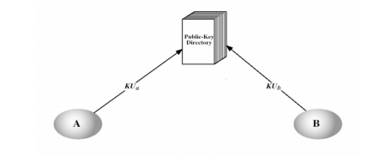
PUBLICLY AVAILABLE DIRECTORY
A greater degree of security can be achieved by maintaining a publicly available dynamic directory of public keys. Maintenance and distribution of the public directory would have to be the responsibility of some trusted entity or organisation.
Image source-http://www.facweb.iitkgp.ac.in/~sourav/KeyManagement.pdf
Charvi KNC 301 CSS Unit-4

Slide 25
PUBLIC-KEY AUTHORITY
Stronger security for public-key distribution can be achieved by providing tighter control over the distribution of public keys from the directory.
central authority maintains a dynamic directory of public keys of all participants. In addition, each participant reliably knows a public key for the authority, with only the authority knowing the corresponding private key.
However this isn’t perfect as the public-key authority could be somewhat of a bottleneck in the system.
The reason for this is that a user must appeal to the authority for a public key for every other user that it wishes to contact. Also the directory of names and public keys maintained by the authority is vulnerable to tampering.
Charvi KNC 301 CSS Unit-4

Slide 26
PUBLIC-KEY CERTIFICATES
An alternative approach to the above is the use of certificates that can be used by participants to exchange keys without contacting a public-key authority.
Each certificate, containing a public key and other information, is created by a certificate authority and is given to the participant with the matching private key---
Four requirements can be placed on this particular scheme:
1. Any participant can read a certificate to determine the name and public key of the certificate’s owner.
2. Any participant can verify that the certificate originated from the certificate authority and is not counterfeit.
3. Only the certificate authority can create and update certificates.
4. Any participant can verify the currency of the certificate.
Charvi KNC 301 CSS Unit-4

Slide 27
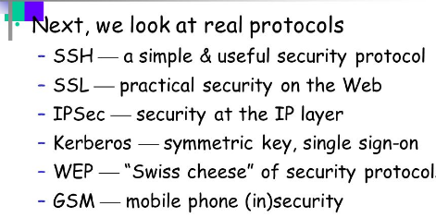
REAL WORLD PROTOCOLS
Charvi KNC 301 CSS Unit-4

Slide 28
REAL WORLD PROTOCOLS
The acronym SSH stands for "Secure Shell." The SSH protocol was designed as a secure alternative to unsecured remote shell protocols. It utilizes a client-server paradigm, in which clients and servers communicate via a secure channel.
The SSH protocol has three layers:
The transport layer. Ensures secure communication between the server and the client, monitors data encryption/decryption, and protects the integrity of the connection. It also performs data caching and compression.
The authentication layer. Conducts the client authentication procedure.
The connection layer. Manages communication channels after the authentication.
Charvi KNC 301 CSS Unit-4

Slide 29
REAL WORLD PROTOCOLS
SSL, or Secure Sockets Layer, is an encryption-based Internet security protocol. It was first developed by Netscape in 1995 for the purpose of ensuring privacy, authentication, and data integrity in Internet communications. SSL is the predecessor to the modern TLS encryption used today.
A website that implements SSL/TLS has "HTTPS" in its URL instead of "HTTP."
Charvi KNC 301 CSS Unit-4

Slide 30
REAL WORLD PROTOCOLS
IPsec is a group of protocols that are used together to set up encrypted connections between devices. It helps keep data sent over public networks secure. IPsec is often used to set up VPNs, and it works by encrypting IP packets, along with authenticating the source where the packets come from.
Within the term "IPsec," "IP" stands for "Internet Protocol" and "sec" for "secure." The Internet Protocol is the main routing protocol used on the Internet; it designates where data will go using IP addresses. IPsec is secure because it adds encryption* and authentication to this process.
*Encryption is the process of concealing information by mathematically altering data so that it appears random. In simpler terms, encryption is the use of a "secret code" that only authorized parties can interpret.
Charvi KNC 301 CSS Unit-4

Slide 31
REAL WORLD PROTOCOLS
Wired Equivalent Privacy (WEP) is a security standard for wireless networks or WiFi. It was a part of the original IEEE 802.11 protocol.
As wireless networks transmit data over radio waves, eavesdropping on wireless data transmissions is relatively easier than in wired networks connected by cables.
WEP aims to provide the same level of security and confidentiality in wireless networks as in wired counterparts.
Charvi KNC 301 CSS Unit-4

Slide 32
REAL WORLD PROTOCOLS
Kerberos was designed to protect your credentials from hackers by keeping passwords off of insecure networks, even when verifying user identities.
Kerberos, at its simplest, is an authentication protocol for client/server applications. It's designed to provide secure authentication over an insecure network.
The protocol was initially developed by MIT in the 1980s and was named after the mythical three-headed dog who guarded the underworld, Cerberus.
Charvi KNC 301 CSS Unit-4

Slide 33
REAL WORLD PROTOCOLS
GSM stands for Global System for Mobile Communication. It is a digital cellular technology used for transmitting mobile voice and data services.
Important facts about the GSM are given below −
The concept of GSM emerged from a cell-based mobile radio system at Bell Laboratories in the early 1970s.
GSM is the most widely accepted standard in telecommunications and it is implemented globally.
GSM owns a market share of more than 70 percent of the world's digital cellular subscribers.
Presently GSM supports more than one billion mobile subscribers in more than 210 countries throughout the world.
GSM provides basic to advanced voice and data services including roaming service. Roaming is the ability to use your GSM phone number in another GSM network.
GSM digitizes and compresses data, then sends it down through a channel with two other streams of user data, each in its own timeslot.
Charvi KNC 301 CSS Unit-4

Slide 34
BASIC TERMINOLOGY
https://www.metacompliance.com/cyber-security-terminology/
Charvi KNC 301 CSS Unit-4

Slide 35

E-MAIL SECURITY CERTIFICATE
During an email transmission over internet, the sender and receipt always worry about the email content not read, tempered or modified by attackers.
The email must be deliver to receipt in the same condition as it was sent by the sender, and also sender’s information must not be changed as well.
To get this thing done an email signing certificate is an ultimate option.
Image source- https://www.google.com/search?q=email+security+certificates&sxsrf=ALeKk00_L_YYCUR12KT
Charvi KNC 301 CSS Unit-4

Slide 36
WHY EMAIL CERTIFICATE
Generally, unencrypted email is easily hackable for cyber attackers whereas they find hard/impossible to crack an encrypted email.
Unencrypted email can be easily spoof able but encrypted email delivers privacy and security.
Issued and installed within minutes
Compatible with every email clients and web browsers
Compatible with all mobile and desktop devices & Operating systems
Available within minutes and easily accessible
Charvi KNC 301 CSS Unit-4

Slide 37
EMAIL SECURITY CERTIFICATE SUPPORT FOLLOWING CLIENT
Microsoft® Outlook & Mail
Microsoft® Outlook Express
Mozilla Thunderbird
Apple Mail
Each S/MIME compliant
Charvi KNC 301 CSS Unit-4

Slide 38
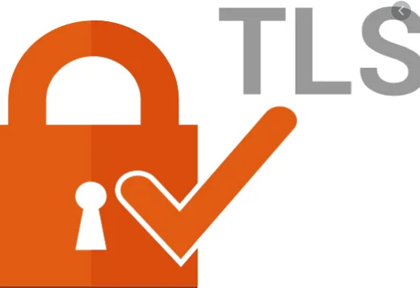
TRANSPORT LAYER SECURITY
Transport Layer Security, or TLS, is a widely adopted security protocol designed to facilitate privacy and data security for communications over the Internet.
A primary use case of TLS is encrypting the communication between web applications and servers, such as web browsers loading a website.
TLS can also be used to encrypt other communications such as email, messaging, and voice over IP (VOIP).
Charvi KNC 301 CSS Unit-4

Slide 39
TRANSPORT LAYER SECURITY
Why should you use TLS?
TLS encryption can help protect web applications from attacks such as data breaches, and DDoS attacks.
Additionally, TLS-protected HTTPS is quickly becoming a standard practice for websites.
For example, the Google Chrome browser is cracking down on non-HTTPS sites, and everyday Internet users are starting to become more wary of websites that don’t feature the HTTPS padlock icon.
Charvi KNC 301 CSS Unit-4

Slide 40
HOW DOES TLS WORK
TLS can be used on top of a transport-layer security protocol like TCP. There are three main components to TLS: Encryption, Authentication, and Integrity.
Encryption: hides the data being transferred from third parties.
Authentication: ensures that the parties exchanging information are who they claim to be.
Integrity: verifies that the data has not been forged or tampered.
Charvi KNC 301 CSS Unit-4

Slide 41
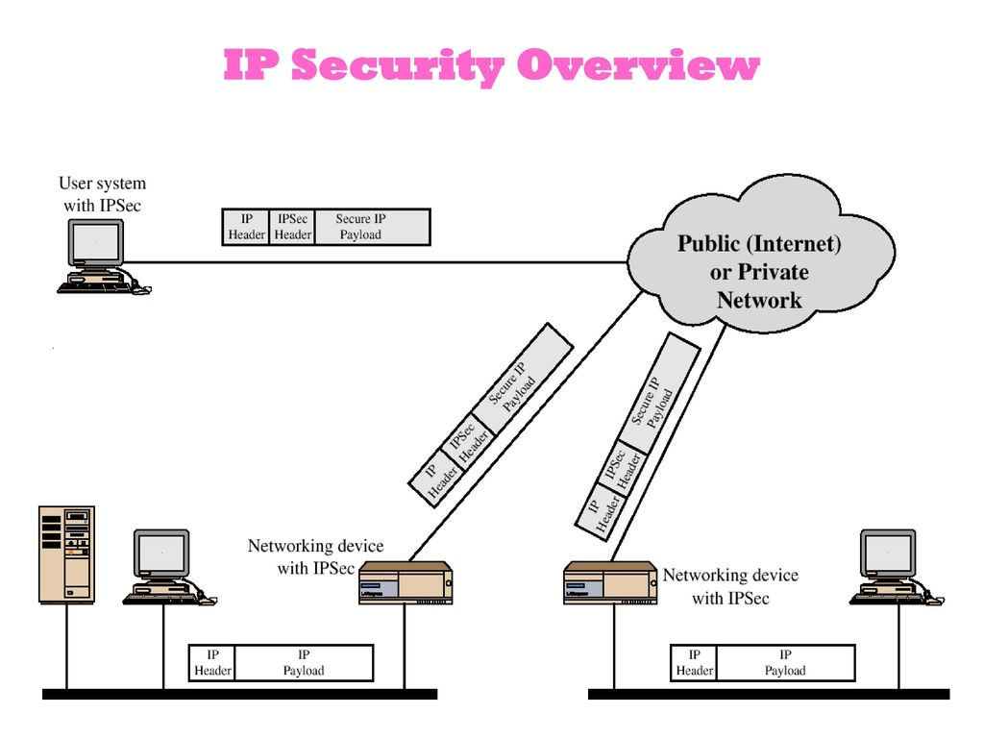
IP SECURITY
In computing, Internet Protocol Security (IPsec) is a secure networkprotocolsuite that authenticates and encrypts the packets of data to provide secure encrypted communication between two computers over an Internet Protocol network. It is used in virtual private networks (VPNs).
https://crypto.stanford.edu/cs155old/cs155-spring16/lectures/13-tcp-dns.pdf
Charvi KNC 301 CSS Unit-4

Slide 42

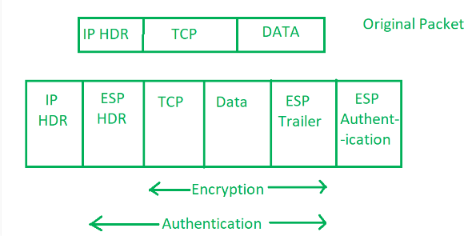
IP SECURITY
Components of IP Security –
It has the following components:
Encapsulating Security Payload (ESP)
Authentication Header (AH)
Internet Key Exchange (IKE)
Charvi KNC 301 CSS Unit-4

Slide 43
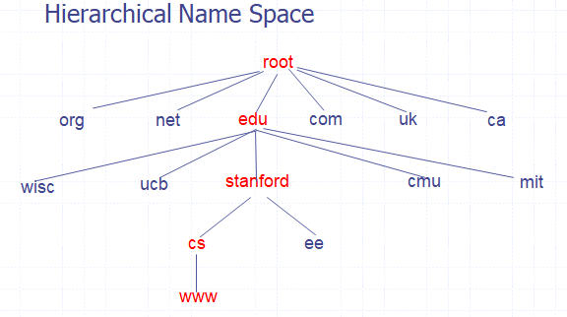
DNS SECURITY
DNS —
Domain Name Service
DNS is the network service that maps Internet domain names to numerical IP addresses
https://crypto.stanford.edu/cs155old/cs155-spring16/lectures/13-tcp-dns.pdf
Charvi KNC 301 CSS Unit-4

Slide 44
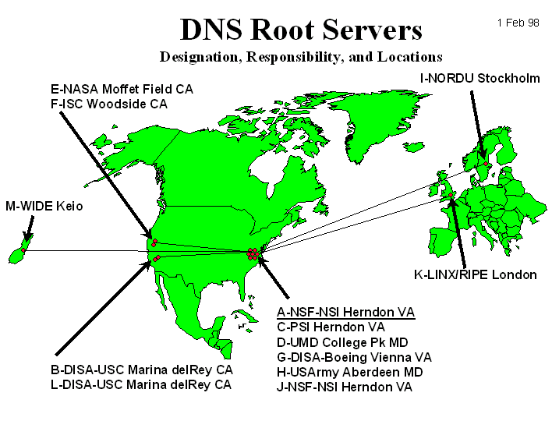
DNS SECURITY
DNS ROOT NAME SERVER-
Hierarchical service
Root name servers for top-level domains
Authoritative name servers for sub domains
Local name resolvers contact authoritative servers when they do not know a name
https://crypto.stanford.edu/cs155old/cs155-spring16/lectures/13-tcp-dns.pdf
Charvi KNC 301 CSS Unit-4

Slide 45
DNS SECURITY
CACHING-
DNS responses are cached
Quick response for repeated translations
Useful for finding servers as well as addresses
  NS records for domains
DNS negative queries are cached
Save time for nonexistent sites, e.g. misspelling
Cached data periodically times out
Lifetime (TTL) of data controlled by owner of data
TTL passed with every record
Charvi KNC 301 CSS Unit-4

Slide 46
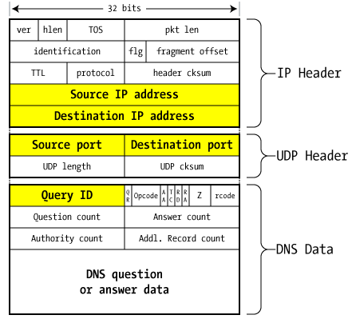
DNS SECURITY
DNS PACKET-
https://crypto.stanford.edu/cs155old/cs155-spring16/lectures/13-tcp-dns.pdf
Charvi KNC 301 CSS Unit-4

Slide 47
WHY DO WE NEED SECURITY IN DNS
A DNS helps point web traffic to the right destination. It is used by everyone, everywhere and all internet traffic flows through it.
For this reason, it is a highly sensitive system which is exposed to many threats from cyber attackers that aim to take control of a DNS, to infect and extract all data from it.
Many modern enterprises are often vulnerable to DNS server security risks because they only use a couple of DNS servers.
As a result, this may leave them incapable of protecting against volumetric attacks, whereby large amounts of traffic to a website may cause servers to crashpreventing users from finding the website.
Besides compromising the way a DNS works, a malicious attack can also aim to exploit security vulnerabilities on the server that runs the DNS services, extracting valuable data such as passwords, usernames and other personal information.
Charvi KNC 301 CSS Unit-4

Slide 48
DNS SECURITY THREATS
Distributed denial of service (DDoS) attacks: A DDoS takes advantage of multiple systems’ security vulnerabilities, such as those compromised by malware, and sends large volumes of traffic to a website or web-based application.
Amplification attacks: This is when hackers exploit vulnerabilities in a DNS server to turn smaller queries into much larger ones, which again, can crash servers. An amplification attack is a type of reflection attack, which involves flooding public DNS with multiple packets
Charvi KNC 301 CSS Unit-4

